Slide 1
SCALA
Basics, Datatypes, Exception Handlings

Slide 2
What is Scala ? – In brief
Scala is a modern multi-paradigm programming language designed to express common programming patterns in a concise, elegant, and type-safe way
Scala, short for Scalable Language
Scala smoothly integrates the features of object-oriented and functional languages.
Scala Programming = Object Oriented Programming + Functional Programming
From the functional programming perspective- each function in Scala is a value and from the object oriented aspect - each value in Scala is an object.
Scala programming language can be found in use at some of the best tech companies like LinkedIn, Twitter, and FourSquare.

Slide 3
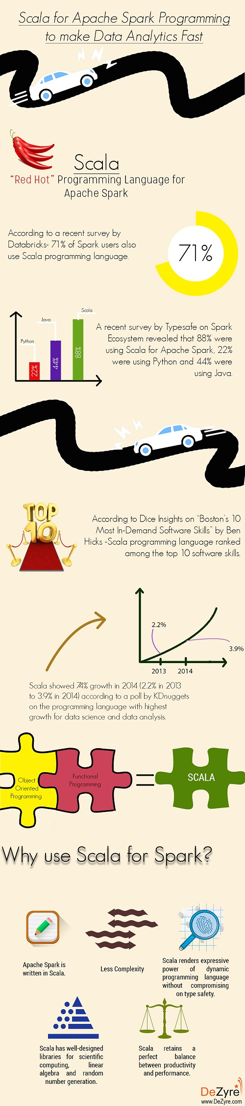
Why learn Scala for Spark ?

Slide 4
Why learn Scala for Spark ?
Scala is designed with parallelism and concurrency in mind for big data applications.
Scala has excellent built-in concurrency support.
Other programming languages like Python or Java have lag in the API coverage.

Slide 5
Some Highlights you should know !!
Scala is a pure object-oriented language in the sense that every value is an object.
Classes are extended by subclassing and a flexible mixin-based composition mechanism as a clean replacement for multiple inheritance.
Scala provides a lightweight syntax for defining anonymous functions, it supports higher-order functions.
The Scala compiler compiles your Scala code into Java Byte Code, which can then be executed by the 'scala' command.
It reduces the number of lines and helps the programmer to code in a type-safe way.
It allows you to write codes in an immutable manner, which makes it easy to apply concurrency and parallelism (Synchronize).

Slide 6
Building blocks of Scala – lets also refresh
Object − Objects have states and behaviors. An object is an instance of a class.
Class − A class can be defined as a template/blueprint that describes the behaviors/states that are related to the class.
Methods − A method is basically a behavior. A class can contain many methods. It is in methods where the logics are written, data is manipulated and all the actions are executed.
Fields − Each object has its unique set of instance variables, which are called fields. An object's state is created by the values assigned to these fields.
Closure − A closure is a function, whose return value depends on the value of one or more variables declared outside this function.
Traits − A trait encapsulates method and field definitions, which can then be reused by mixing them into classes. Traits are used to define object types by specifying the signature of the supported methods.

Slide 7
Key Rules !!
def main(args: Array[String]) − Scala program processing starts from the main() method which is a mandatory part of every Scala Program
Case Sensitivity − Scala is case-sensitive, which means identifier Hello and hello would have different meaning in Scala.
Program File Name − Name of the program file should exactly match the object name. When saving the file you should save it using the object name and append ‘.scala’ to the end of the name.
Method Names − All method names should start with a Lower Case letter. If multiple words are used to form the name of the method, then each inner word's first letter should be in Upper Case. Example : def myMethodName()

Slide 8
Identifiers
Names used for objects, classes, variables and methods are called identifiers.
An alphanumeric identifier starts with a letter or an underscore, which can be followed by further letters, digits, or underscores. Ex : age, salary, _value, __1_v
An operator identifier consists of one or more operator characters. Operator characters are printable ASCII characters such as +, :, ?, ~ or #. Ex: + ++ :::
A mixed identifier consists of an alphanumeric identifier, which is followed by an underscore and an operator identifier. Ex: unary_+, myvar_=
A literal identifier is an arbitrary string enclosed in back ticks (` . . . `). Ex: ‘yield’ ‘<clinit>’

Slide 9
Scala Keywords – Have a glance
abstract | case | catch | class
def | do | else | extends
false | final | finally | for
forSome | if | implicit | import
lazy | match | new | Null
object | override | package | private
protected | return | sealed | super
this | throw | trait | Try
true | type | val | Var
while | with | yield
- | : | = | =>
<- | <: | <% | >:
# | @

Slide 10
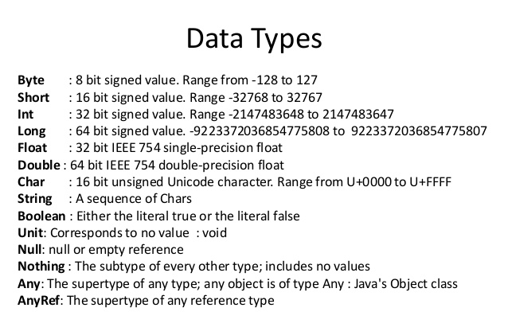
Scala Datatypes

Slide 11
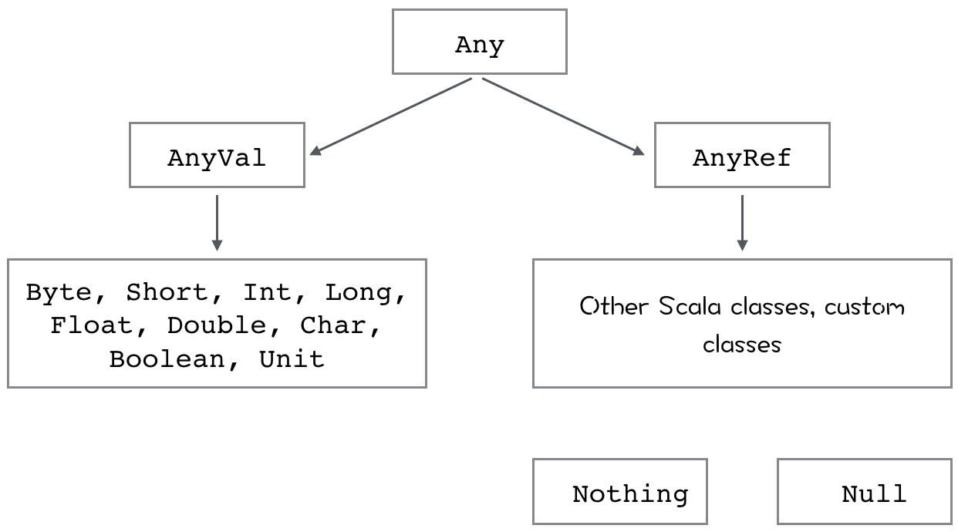
Scala Datatypes – inter-related

Slide 12
Variables
Variable that can change value is called mutable variable.
Example : val or val VariableName : DataType = [Initial Value]
Variable Type Interface : When you assign an initial value to a variable, the Scala compiler can figure out the type of the variable based on the value assigned to it.
Example : var myVar = 10; val myVal = "Hello, Scala!";
Multiple Assignments : val (myVar1, myVar2) = Pair(40, "Foo")
Variable Scope
1) Fields are variables that belong to an object. The fields are accessible from inside every method in the object.
2) Method parameters are variables, which are used to pass the value inside a method, when the method is called.
3) Local variables are variables declared inside a method.

Slide 13
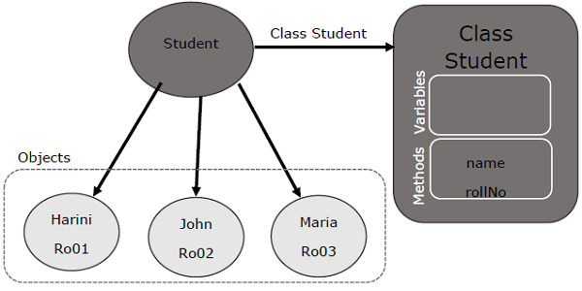
Classes and Objects

Slide 14
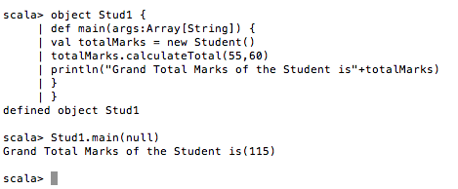
Classes and Objects – Basic Example

Slide 15
Singleton Objects
Scala is more object-oriented than Java because in Scala, we cannot have static members. Instead, Scala has singleton objects.
A singleton is a class that can have only one instance, i.e., Object. You create singleton using the keyword object instead of class keyword.

Slide 16
Access Modifiers
A private member is visible only inside the class or object that contains the member definition.
class Outer {
class Inner {
private def f() { println("f") }
class InnerMost {
f() // OK
}
}
(new Inner).f() // Error: f is not accessible
}

Slide 17
Access Modifiers
A protected member is only accessible from subclasses of the class in which the member is defined.
package p {
class Super {
protected def f() { println("f") }
}
class Sub extends Super {
f()
}
class Other {
(new Super).f() // Error: f is not accessible
}
}

Slide 18
Access Modifiers
Unlike private and protected members, it is not required to specify Public keyword for Public members.
class Outer {
class Inner {
def f() { println("f") }
class InnerMost {
f() // OK
}
}
(new Inner).f() // OK because now f() is public
}

Slide 19

Operators – Search, its fun

Slide 20
If statement – Same old Saga
‘if’ statement consists of a Boolean expression followed by one or more statements.
object Demo {
def main(args: Array[String]) {
var x = 10;
if( x < 20 ){
println("This is if statement");
}
}
}

Slide 21
What “else” ? – If-else
An ‘if’ statement can be followed by an optional else statement, which executes when the Boolean expression is false.
if(Boolean_expression){
//Executes when the Boolean expression is true
} else{
//Executes when the Boolean expression is false
}

Slide 22
Loop – While
A while loop statement repeatedly executes a target statement as long as a given condition is true.
object Demo {
def main(args: Array[String]) {
// Local variable declaration:
var a = 10;
// while loop execution
while( a < 20 ){
println( "Value of a: " + a );
a = a + 1;
}
}
}

Slide 23
Loop – Do while loop
A do-while loop is similar to a while loop, except that a do-while loop is guaranteed to execute at least one time.
object Demo {
def main(args: Array[String]) {
// Local variable declaration:
var a = 10;
// do loop execution
do {
println( "Value of a: " + a );
a = a + 1;
}
while( a < 20 )
}
}

Slide 24
Loops – For
A for loop is a repetition control structure that allows you to efficiently write a loop that needs to execute a specific number of times.
object Demo {
def main(args: Array[String]) {
var a = 0;
// for loop execution with a range
for( a <- 1 to 10){
println( "Value of a: " + a );
}
}
}

Slide 25
Exceptions – Handlings
Throwing an exception looks the same as in Java. You create an exception object and then you throw it with the throw keyword. Ex: throw new IllegalArgumentException
Scala allows you to try/catch any exception in a single block and then perform pattern matching against it using case blocks.
try {
val f = new FileReader("input.txt")
} catch {
case ex: FileNotFoundException =>{
println("Missing file exception")
}
case ex: IOException => {
println("IO Exception")
}
}

Slide 26
Exception handlings
You can wrap an expression with a finally clause if you want to cause some code to execute no matter how the expression terminates
try {
val f = new FileReader("input.txt")
} catch {
case ex: FileNotFoundException => {
println("Missing file exception")
}
case ex: IOException => {
println("IO Exception")
}
} finally {
println("Exiting finally...")
}

Slide 27


